Slide 1
OTP BASED SMART WIRELESS LOCKING SYSTEM

Slide 2
TABLE OF CONTENTS:
Introduction
Literature Survey
Aim of the Project
Objectives
Block diagram
Circuit Diagram
Methodology
Hardware/Software requirements
Results
Advantages
Applications
Conclusion
References

Slide 3
INTRODUCTION
What is OTP based smart wireless locking system?
An OTP (One-Time Password) Based Smart Wireless Locking System is a type of electronic locking system that uses a one-time password (OTP) as an additional layer of security for authentication and access control.
The OTP based smart wireless locking system utilizes the power of Arduino, a popular open-source electronics platform, to create a secure and efficient locking mechanism.
This presentation focuses on the implementation of a Wireless OTP Locking System using Arduino. We will explore its components, functionalities, and the benefits it offers in securing access to sensitive areas.

Slide 4
LITERATURE SURVEY
Paper Title | Year | Journal | Methodology | Advantages | Conclusion
"Review Paper on Door Lock Security Systems" | 2020 | 2020 International Conference on Convergence to Digital World - Quo Vadis (ICCDW) | The research will include traditional door lock system, RFID based system, gesture-based systems, Bluetooth and GSM technology- based and various other technologies used in the door lock security systems. | Offers features like keyless entry, and remote locking to prevent unauthorized access Unlock doors via smartphone eliminating the need for physical keys. | Enhanced Security: OTP (One-Time Password) based wireless locking systems offer a higher level of security compared to traditional locking mechanisms, as the password is valid for a limited time and can only be used once, reducing the risk of unauthorized access.
Smart Lock System using IoT , Embedded & Machine Learning | 2022 | 2022 IEEE 7th International conference for Convergence in Technology (I2CT) | The device has been constructed based on Raspberry-pi 4 to render the home only accessible to the registered members in the system. | This system is designed to enhance the protection of homes , with the help of this device, we will be able to make residences more secure. | Convenience and Accessibility: These systems provide users with remote access and convenience, as they can be unlocked via mobile devices or other wireless communication methods, eliminating the need for physical keys.

Slide 5
Paper Title | Year | Journal | Methodology | Advantages | Conclusion
Smart Lock Using IoT | 2022 | 2022 Interdisciplinary Research in Technology and Management (IRTM) | It works on the IoT system which makes it more robust. | This system can be integrated with a traditional locking system where it sends the notification to the user's mobile phone along with the buzzer alert. | Real-Time Control and Monitoring: systems allow for real-time control and monitoring, enabling users to track access logs, generate temporary codes, and manage access remotely, which is ideal for both personal and business security applications.
"IoT Enhanced Smart Door Locking System" | 2020 | 2020 Third International Conference on Smart Systems and Inventive Technology (ICSSIT) | The door lock system determines the security by allowing the owner to monitor the buildings with a Smartphone-controlled, Bluetooth-connected system using Arduino UNO. | If the credentials are invalid, the buzzer rings and an SMS alert is sent to the owner of the building which enhances the security | Cost-Effective and Scalable: Wireless OTP locking systems are cost-effective in the long term, as they eliminate the need for expensive key management systems, and they are easily scalable for a variety of applications, from home security to large-scale commercial facilities.

Slide 6
AIM OF THE PROJECT
To design and develop a secure and efficient OTP-based smart wireless locking system that allows users to control and monitor access to a physical lock. The system will generate time-sensitive One-Time Passwords (OTPs) that are sent to the user's mobile device via wireless communication, ensuring that only authorized individuals can unlock the system. The project aims to enhance security by combining OTP technology with wireless access, reducing the risks of unauthorized entry while providing a user-friendly interface for real-time control.

Slide 7
OBJECTIVES
To integrate wireless communication using Bluetooth into the locking mechanism is the main objective of the project.
To develop a wireless locking and unlocking system using smartphone.
Implement the Arduino UNO Microcontroller as the core controller unit to manage hardware components like servo motor for locking mechanisms.
To create a mobile-based user interface , where users can request OTP’s, monitor lock status.

Slide 8
Block Diagram
ARDUINO
UNO
ANDROID
MOBILE
POWER SUPPLY
SERVO MOTOR
BLUETOOTH
----------
LED
Fig : BLOCK DIAGRAM OF OTP BASED SMART WIRELESS LOCKING SYSTEM USING ARDUINO

Slide 9
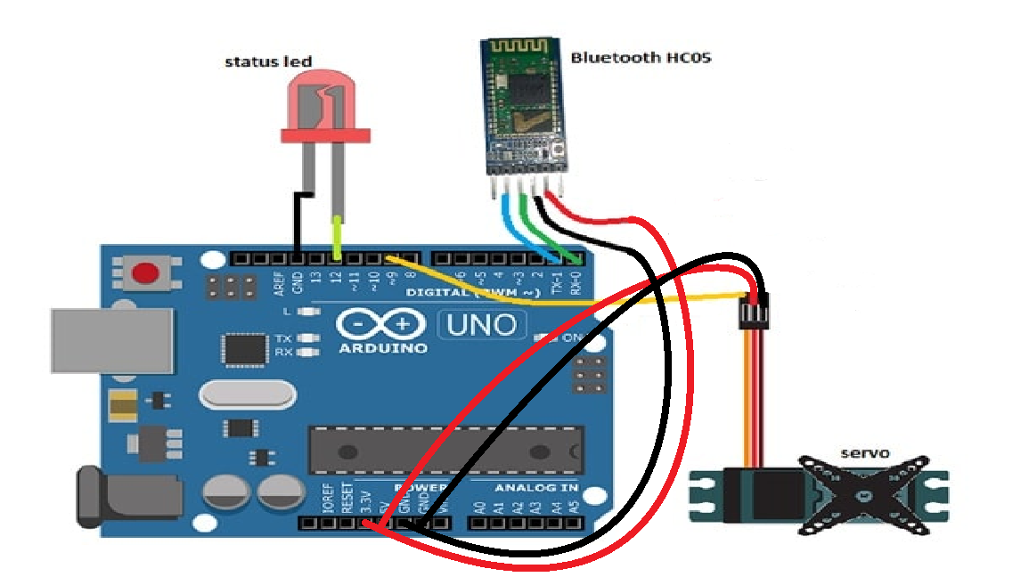
CIRCUIT DIAGRAM
.

Slide 10
METHODOLOGY
The methodology for an "OTP-based locker system using Arduino" begins with identifying the need for a secure, user-friendly, and cost-effective storage solution. The primary objective is to create a system where locker access is controlled through a one-time password (OTP) for enhanced security. The project involves analysing the necessary hardware components such as an Arduino board, servo motor, and LED Bulb, alongside required software tools like the MIT app inventor, Arduino IDE and specific libraries. The system design integrates these components: the servo motor acts as the locking mechanism, and the LED provides user feedback.

Slide 11
After assembling the circuit, we undergo thorough testing and debugging to verify each module's functionality individually, as well as in an integrated setup.
Testing includes assessing the system's response to correct and incorrect OTP entries, communication reliability, and error handling. Validation involves running real-world simulations to ensure that the locker operates securely and consistently. The final step is documenting the process, which includes detailing the design, circuit diagrams, source code, and testing results, as well as providing insights into potential future enhancements. This structured approach ensures a comprehensive development and a successful presentation of the OTP-based locking system.

Slide 12
HARDWARE/SOFTWARE REQUIREMENTS:
1.Arduino UNO
Microcontroller
Pins
Power
Reset button
Open-source
2.Bluetooth Hc05
3. 5V Battery

Slide 13
4.Servo Motor
Signal Pin (Control)
Power (VCC):
Ground (GND):
5.LED
Anode (+)
Cathode (-)
6. MIT App Inventor
7. The Arduino Uno IDE

Slide 14
HARDWARE DESCRIPTON
1)Arduino UNO :
Microcontroller : The Arduino Uno is a microcontroller board based on the ATmega328P. The ATmega328P has 1kb of EEPROM, which is memory that doesn't erase when the board is powered off.
Pins : The Arduino Uno has 14 digital input/output pins and 6 analog inputs. These pins can be used to connect hardware components and enhance the board's capabilities.
Power : The Arduino Uno can be powered by a USB connection, an AC-to-DC adapter, or a battery. It also has voltage regulation features.
Reset button : The Arduino Uno has a reset button for restarting programs. However, the board can also be reset by the software running on a connected computer.

Slide 15
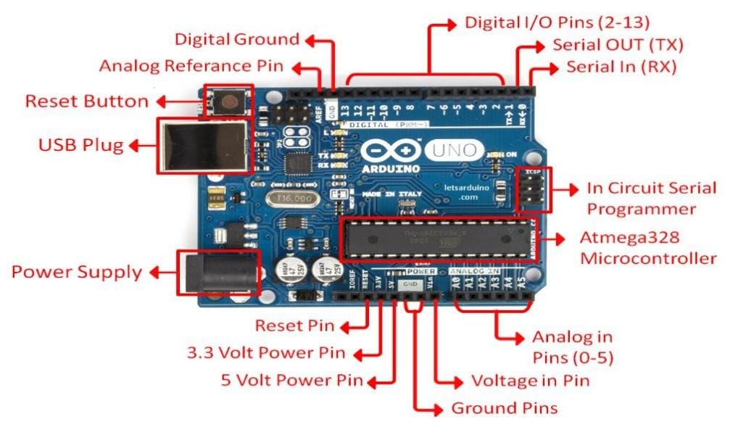
Open-source : The Arduino Uno is an open-source platform, which means that the boards and software are readily available. Anyone can modify and optimize the boards for better functionality.

Slide 16
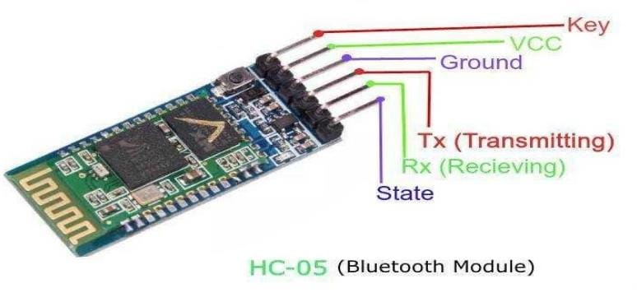
2)Bluetooth Hc05:
The HC-05 Bluetooth module is a compact, cost-effective wireless communication module
Bluetooth Version: 2.0+EDR (Enhanced Data Rate)
Operating Voltage: 3.3V
Communication Interface: UART/TTL
Operating Frequency: 2.4GHz ISM band
Dimensions: 26.9 x 13 x 2.2 mm
Weight: 5 Grams
3)5V Battery:
A battery is a source of electric power consisting of one or more electrochemical cells with external connections for powering electrical devices.

Slide 17
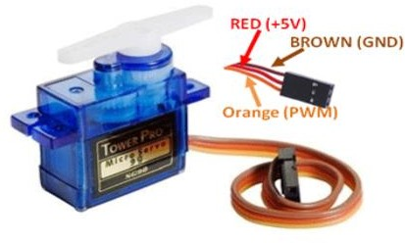
4)Servo Motor:
It is basically used for performing the locking action which have very high torque. A servo motor is a Rotary actuator or linear actuator that allows for precise control of angular or linear accumulator angular or linear position, velocity, and acceleration.
Signal Pin (Control): Connects to a PWM-enabled digital pin on the Arduino (e.g., pin 9 or 10). It controls the angle of the servo.
Power (VCC): Connects to the 5V pin on the Arduino for power.
Ground (GND): Connects to the GND pin on the Arduino

Slide 18
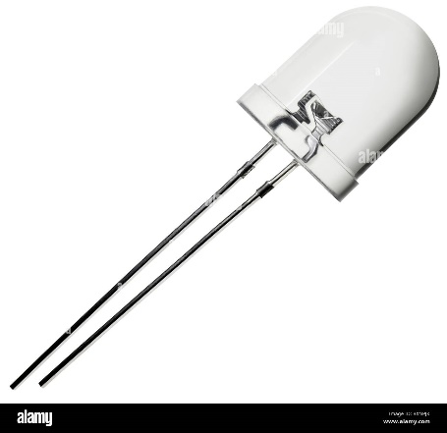
5)LED
Led it used for showing whether our entered OTP is correct or not. If OTP matched, then servo motor performed action and Led will glow
Anode (+): Connect the longer leg of the LED (positive) to a digital pin on the Arduino through a current-limiting resistor (220-330 ohms).
Cathode (-): Connect the shorter leg (negative) directly to the GND pin on the Arduino

Slide 19
SOFTWARE DESCRIPTION
MIT App Inventor: is a free, open-source , visual programming tool that allows users to create apps for Android and iOS devices.
MIT App Inventor's goal is to democratize software development by making it easier for people to create technology instead of just consuming it.
The Arduino Uno IDE :(Integrated Development Environment) is the official software used for programming Arduino boards, including the Arduino Uno. It provides a user-friendly platform to write, compile, and upload code (sketches) to the board. It's free to use and can be programmed using C and C++.

Slide 20
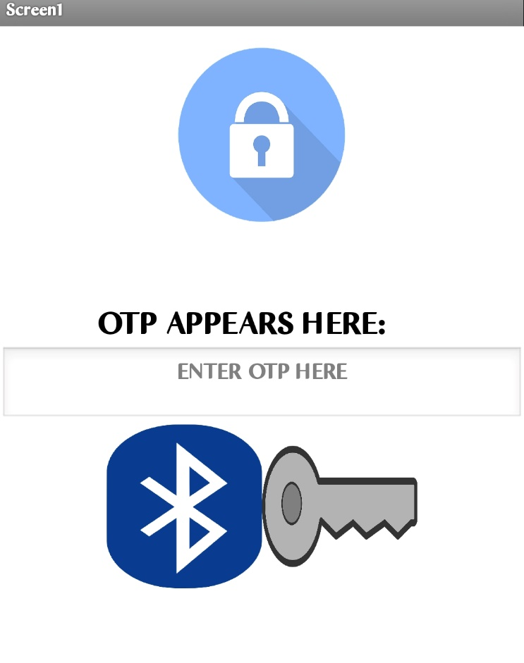
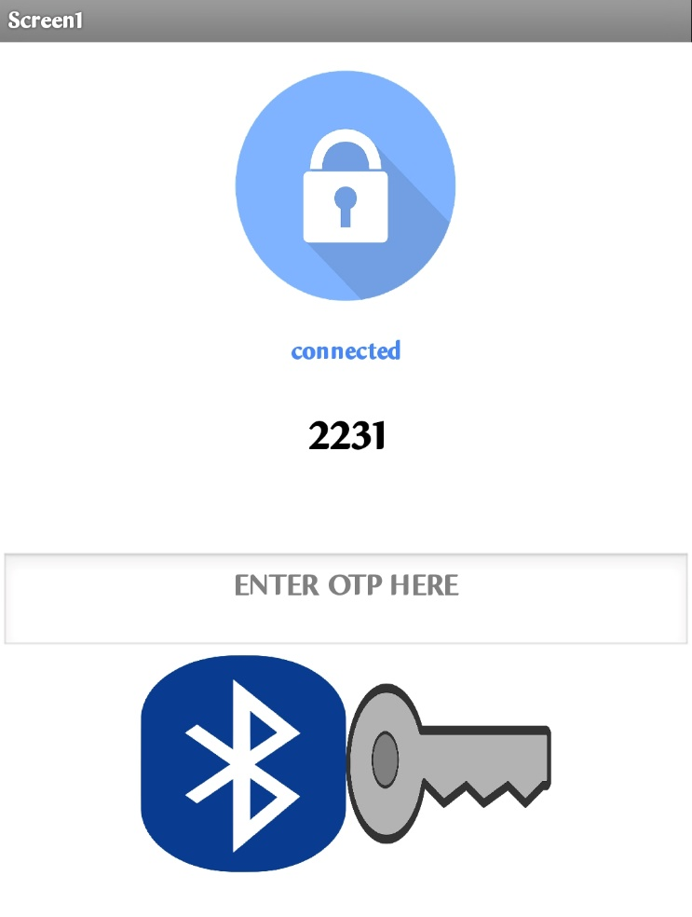
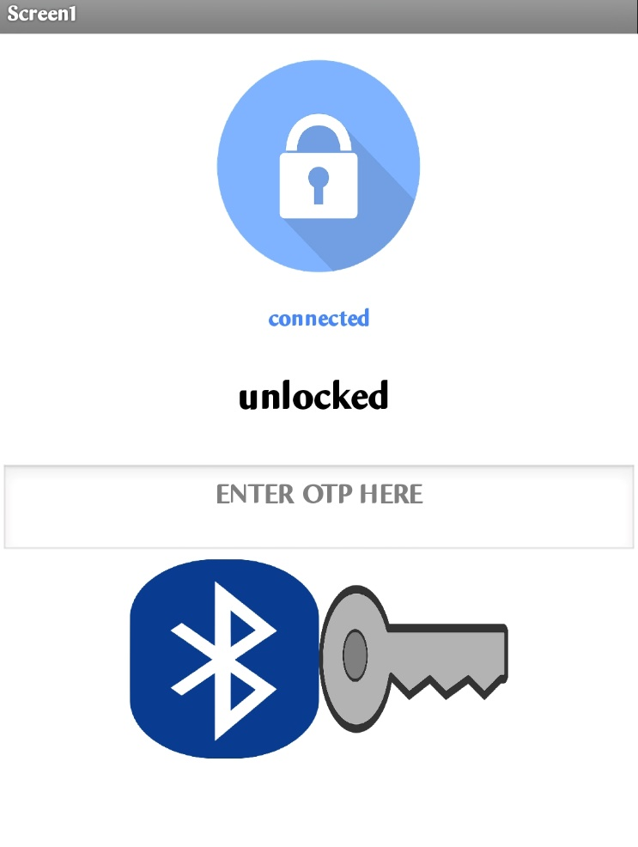
RESULTS
User interface of MIT APP Inventor

Slide 21
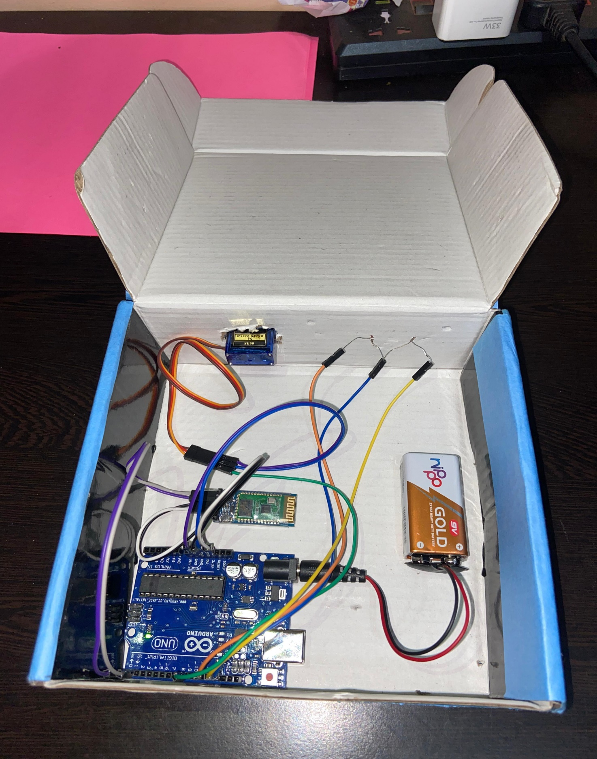
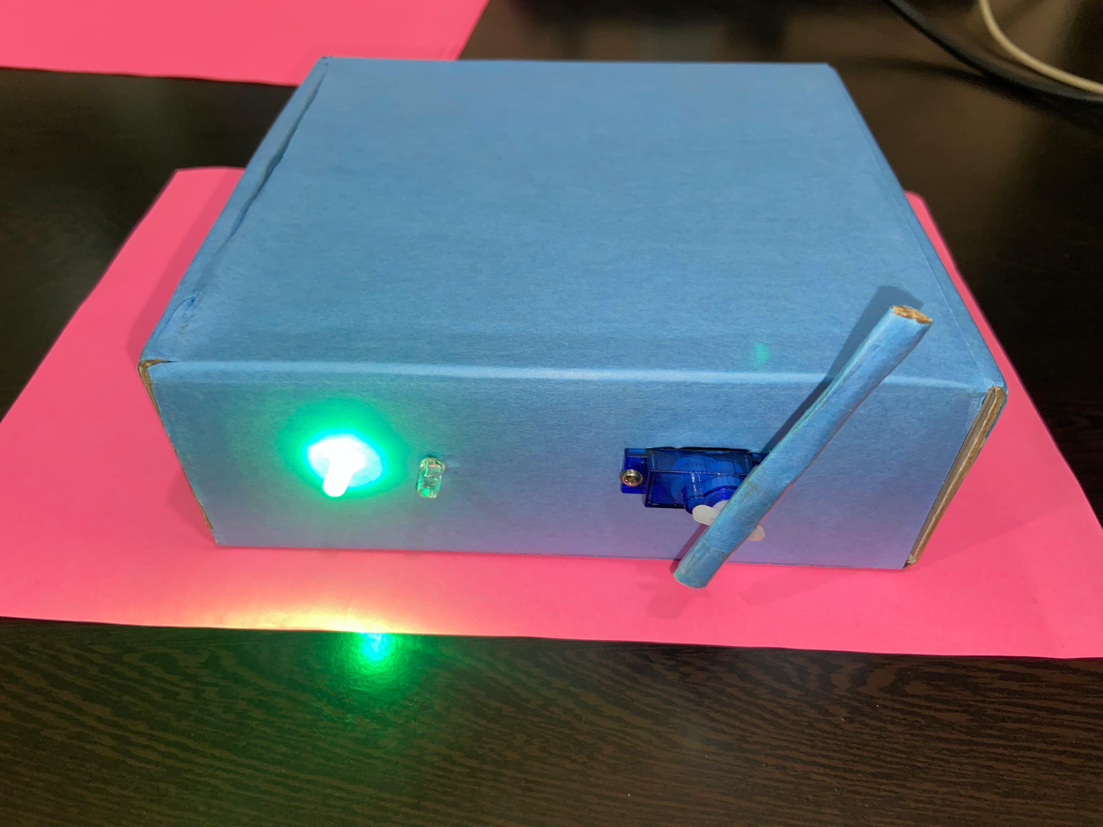
PROTOTYPE of OTP based Wireless Locking System

Slide 22
ADVANTAGES:
Easy Access: Users can access their lockers using a smartphone app, eliminating the need for physical keys or combinations.
Cost Effective : Components are less expensive.
User friendly :Easy to build than conventional methods.
Lower Operating Costs
Lower Power Consumption
No Need for Internet: OTP-based systems can work offline, generating codes via secure algorithms on both devices.
Improved User Experience: The system provides a convenient and secure way for users to access their lockers.
Low Maintenance: Since there are no mechanical parts like traditional locks, wear and tear is minimal.

Slide 23
APPLICATION:
Schools and Universities: Secure storage of laptops, tablets, and other electronic devices.
Gyms and Fitness Centers: Secure storage of personal belongings, such as wallets, phones, and keys.
Hospitals and Healthcare Facilities: Secure storage of medical records, equipment, and patient belongings.
Package Delivery Lockers: Secure storage of packages for delivery and pickup.
Retail stores: Secure storage of high-value items, such as jewelry and electronics.

Slide 24
CONCLUSION:
The OTP-based wireless locking system using Arduino effectively demonstrates a secure and automated approach to access control by leveraging one-time password authentication and wireless communication. The system operates by generating a unique OTP, transmitted to the user via wireless modules such as Bluetooth. Upon receiving the OTP, the Arduino microcontroller validates the input against the generated code, triggering the locking or unlocking mechanism accordingly. This dynamic and real-time authentication ensures enhanced security compared to static password methods .The seamless working of the Arduino, coupled with precise control of locking mechanisms and user-friendly OTP generation, highlights the system’s practicality for applications such as home security, vehicle access, and industrial safety. The implementation is reliable, cost-effective, and highly adaptable. Future developments could include incorporating additional layers of security, such as encryption or biometric verification, to further improve the system’s robustness and applicability.

Slide 25
REFERENCES:
1) Shrajna Shetty; Shubham Shetty; Varsha Vishwakarma; Smita Patil, "Review Paper on Door Lock Security Systems" 2020 International Conference on Convergence to Digital World - Quo Vadis (ICCDW), DOI: 10.1109/ICCDW45521.2020.9318636
2) Pragati Raizada; Srishti Gupta; Manas Das; Palak Rastogi; Divya Arora, "Smart Lock System using IoT, Embedded & Machine Learning", 2022 IEEE 7th International conference for Convergence in Technology (I2CT), DOI:10.1109/I2CT54291.2022.9824012
3) Sourav Bhattacharya; Swarnajoy Basak; Ritwik Chakraborty; Upalabdhi Dey, "Smart Lock Using IoT", 2022 Interdisciplinary Research in Technology and Management (IRTM), DOI: 10.1109/IRTM54583.2022.9791563
4) M Shanthini; G Vidya; R Arun, "IoT Enhanced Smart Door Locking System", 2020 Third International Conference on Smart Systems and Inventive Technology (ICSSIT), DOI: 10.1109/ICSSIT48917.2020.9214288

Slide 26
COMPONENTS | QUANTITY | DESCRIPTION | COST APPROX(INR)
Arduino Uno | 1 | For Programming | 600/-
Micro Servo Motor | 1 | Unlocking Movement | 180/-
Bluetooth HC 05 | 1 | Wireless connection | 140/-
Wires | few | wired connection | 20/-
Battery | 1 | 5V | 30/-
TOTAL |  |  | 970/-

Slide 27
TIME STAMP
TIME | DISCRIPTION
25/9/2024 | Selecting our project
30/9/2024 | Meeting our designated guide
7/10/2024 | We are gathering the necessary hardware components for our mini-project
17/11/2024 | gathering the necessary SOFTWARE for our mini-project
14/12/2024 | Completing our mini project

Slide 28
THANK YOU

